Slide 1
2
Business Intelligence
Dr. Asawari Dudwadkar (Asst. Prof. Dept. of Electronics)

Slide 2
Managers and Decision Making
What Is Business Intelligence?
Business Intelligence Applications for Data Analysis
Business Intelligence Applications for Presenting Results

Slide 3
The Manager’s Job and Decision Making
Management: a process by which an organization achieves its goals through the use of resources (people, money, materials, and information).
Three Basic Roles of Managers (Mintzberg, 1973):
Interpersonal roles: figurehead, leader, liaison
Informational roles: monitor, disseminator, spokesperson, analyzer
Decisional roles: entrepreneur, disturbance handler, resource allocator, negotiator
Notes:
Management: a process by which an organization achieves its goals through the use of resources (people, money, materials, and information).
Three Basic Roles of Managers (Mintzberg, 1973):
1. Interpersonal roles: fi gurehead, leader, liaison
2. Informational roles: monitor, disseminator, spokesperson, analyzer
3. Decisional roles: entrepreneur, disturbance handler, resource allocator, negotiator

Slide 4
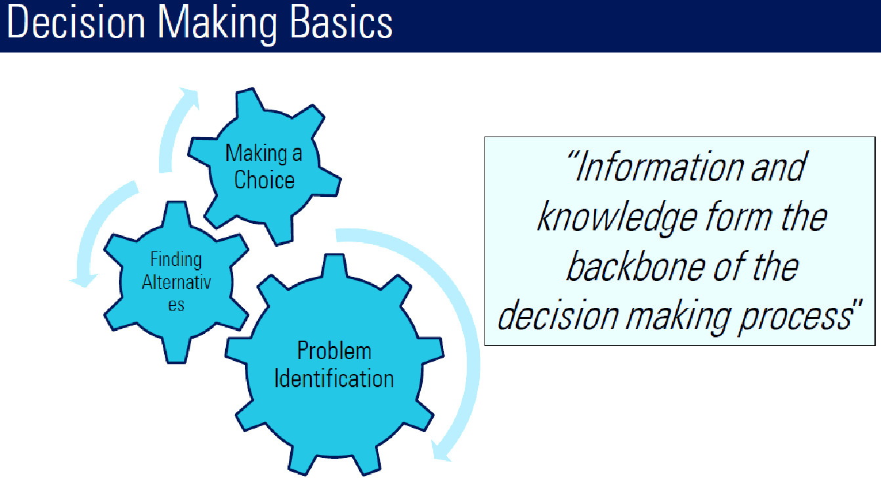

Slide 5
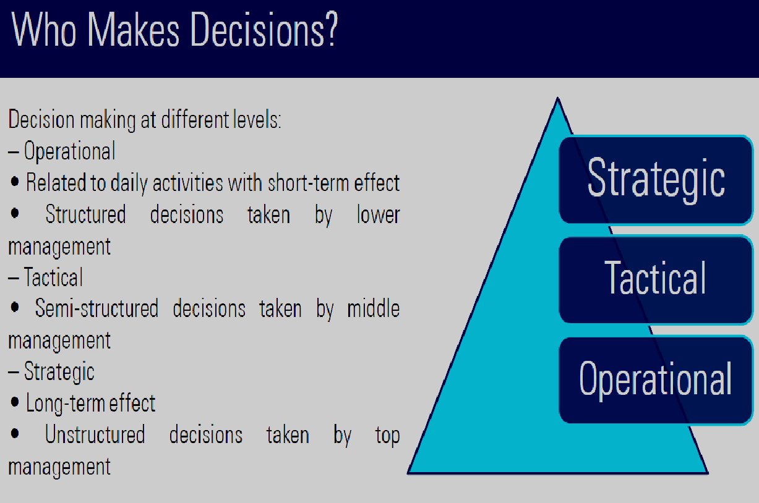

Slide 6
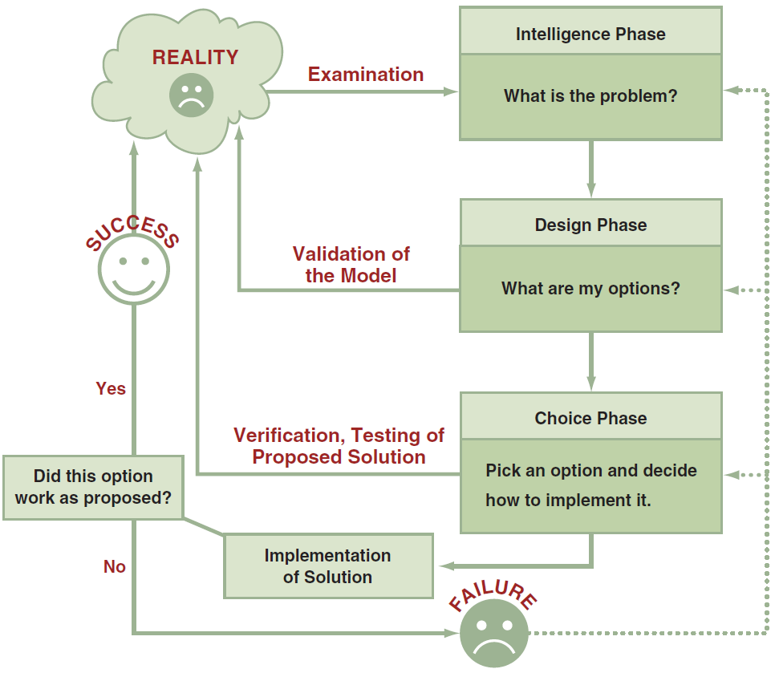
The Process and Phases in Decision Making
Notes:
Decision: a choice among two or more alternatives that individuals and groups make. Decisions are diverse and are made continuously.
Phases of the Decision Making Process:
Intelligence Phase: managers examine a situation and then identify and defi ne the problem or opportunity.
Design Phase: decision makers construct a model for addressing the situation. They perform this task by making assumptions that simplify reality and by expressing the relationships among all of the relevant variables. Managers then validate the model by using test data. Finally, decision makers set criteria for evaluating all of the potential solutions that are proposed.
Choice Phase: involves selecting a solution or course of action that seems best suited to resolve the problem. Th is solution (the decision) is then implemented.
Implementation Phase: is successful if the proposed solution solves the problem or seizes the opportunity. If the solution fails, then the process returns to the previous phases. Computer-based decision support assists managers in the decision-making process.

Slide 7
The Process and Phases in Decision Making
Decision: a choice among two or more alternatives that individuals and groups make. Decisions are diverse and are made continuously.
Phases of the Decision Making Process:
Intelligence Phase: managers examine a situation and then identify and define the problem or opportunity.
Design Phase: decision makers construct a model for addressing the situation. They perform this task by making assumptions that simplify reality and by expressing the relationships among all of the relevant variables. Managers then validate the model by using test data. Finally, decision makers set criteria for evaluating all of the potential solutions that are proposed.
Choice Phase: involves selecting a solution or course of action that seems best suited to resolve the problem. This solution (the decision) is then implemented.
Implementation Phase: is successful if the proposed solution solves the problem or seizes the opportunity. If the solution fails, then the process returns to the previous phases. Computer-based decision support assists managers in the decision-making process.
Notes:
Decision: a choice among two or more alternatives that individuals and groups make. Decisions are diverse and are made continuously.
Phases of the Decision Making Process:
Intelligence Phase: managers examine a situation and then identify and defi ne the problem or opportunity.
Design Phase: decision makers construct a model for addressing the situation. They perform this task by making assumptions that simplify reality and by expressing the relationships among all of the relevant variables. Managers then validate the model by using test data. Finally, decision makers set criteria for evaluating all of the potential solutions that are proposed.
Choice Phase: involves selecting a solution or course of action that seems best suited to resolve the problem. Th is solution (the decision) is then implemented.
Implementation Phase: is successful if the proposed solution solves the problem or seizes the opportunity. If the solution fails, then the process returns to the previous phases. Computer-based decision support assists managers in the decision-making process.

Slide 8
Why Managers Need IT Support?
The number of alternatives is constantly increasing
Most decisions are made under time constraints
Uncertainty in the decision environment
Group decision making required

Slide 9
What IT are Available to Support Managers
Business Intelligence (BI): is a broad category of applications, technologies, and processes for gathering, storing, accessing, and analyzing data to help business users make better decisions.
BI applications enable decision makers to quickly ascertain the status of a business enterprise by examining key information.
Notes:
Business Intelligence (BI): is a broad category of applications, technologies, and processes for gathering, storing, accessing, and analyzing data to help business users make better decisions. BI applications enable decision makers to quickly ascertain the status of a business enterprise by examining key information.

Slide 10
A Framework for Computerized Decision Analysis
Problem Structure: where decision-making processes fall along a range from highly structured to highly unstructured.
Nature of Decisions:
All managerial decisions fall into one of three broad categories:
Operational Control: executing specific tasks efficiently and effectively.
Management Control: acquiring and using resources efficiently in accomplishing organizational goals.
Strategic Planning: the long-range goals and policies for growth and resource allocation.
Notes:
Problem Structure: where decision-making processes fall along a continuum ranging from highly structured to highly unstructured.
Nature of Decisions:
All managerial decisions fall into one of three broad categories:
Operational Control: executing specific tasks efficiently and effectively.
Management Control: acquiring and using resources efficiently in accomplishing organizational goals.
Strategic Planning: the long-range goals and policies for growth and resource allocation.

Slide 11
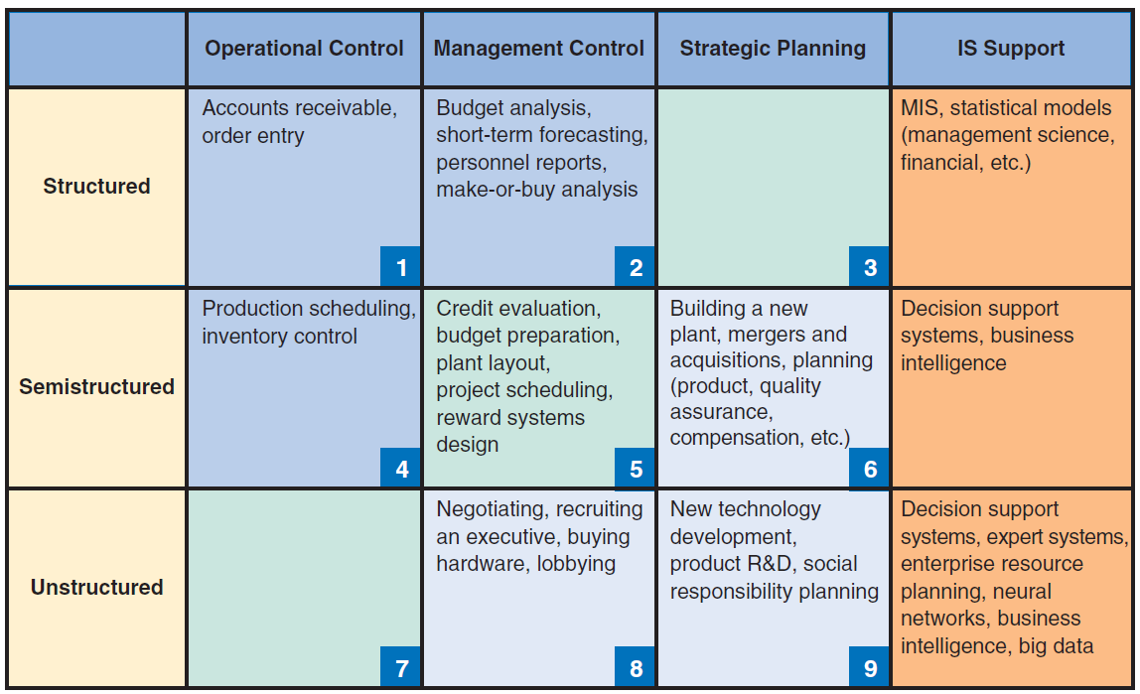
Decision Support Framework

Slide 12
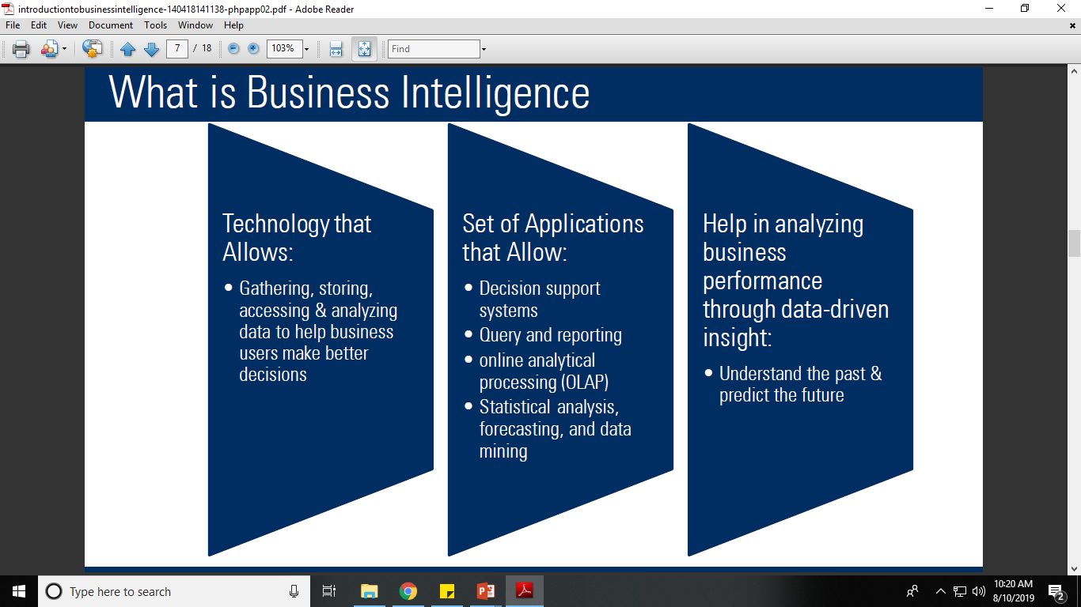

Slide 13
The Scope of Business Intelligence
The Development of One or a Few Related BI Applications
The Development of Infrastructure to Support Enterprisewide BI
Support for the Organizational Transformation
Notes:
Business Intelligence (BI): is a broad category of applications, technologies, and processes for gathering, storing, accessing, and analyzing data to help business users make better decisions. BI applications enable decision makers to quickly ascertain the status of a business enterprise by examining key information.

Slide 14
’S ABOUT BUSINESS 5.1
Predicting Airplane Arrivals More Accurately
Do you think that satellite-based navigation will meet resistance among air traffic controllers? Why or why not?
Do you think that pilots will object to having “smart assistants” help them make decisions? Why or why not?
Do you think the overall response of the airlines to satellite-based navigation and smart assistants for pilots will be positive or negative? Support your answer.
What is the relationship between analytics and smart assistants for pilots?

Slide 15

’S ABOUT BUSINESS 5.2
Cardlytics Analyzes Customer Buying Behaviors
Discuss the advantages and disadvantages of Cardlytics’s data analyses for the customer. Use specific examples in your answers.
Discuss the advantages and disadvantages of Cardlytics’s data analyses for the merchants. Use specific examples in your answers.

Slide 16
Business Intelligence Applications for Data Analysis
Multidimensional Analysis or Online Analytical Processing
Data Mining
Decision Support Systems

Slide 17
Multidimensional Analysis or Online Analytical Processing
Online Analytical Processing (OLAP - also referred to as multidimensional analysis) capabilities. OLAP involves “slicing and dicing” data stored in a dimensional format, drilling down in the data to greater detail, and aggregating the data.
Notes:
Online Analytical Processing (OLAP - also referred to as multidimensional analysis) capabilities. OLAP involves “slicing and dicing” data stored in a dimensional format, drilling down in the data to greater detail, and aggregating the data.

Slide 18
Data Mining
Data Mining: the process of searching for valuable business information in a large database, data warehouse, or data mart.
Data Mining Can Perform Two Basic Operations:
(1) predicting trends and behaviors
(2) identifying previously unknown patterns.
Notes:
Data Mining: the process of searching for valuable business information in a large database, data warehouse, or data mart.
Data Mining Can Perform Two Basic Operations:
(1) predicting trends and behaviors
(2) identifying previously unknown patterns.

Slide 19
Decision Support Systems (DSS)
Decision support systems (DSS) are interactive software-based systems that help managers in decision-making by accessing large volumes of information generated from various related information systems
DSS uses the summary information, exceptions, patterns, and trends using the analytical models.
A decision support system helps in decision-making but does not necessarily give a decision itself.
The decision makers compile useful information from raw data, documents, personal knowledge, and/or business models to identify and solve problems and make decisions.

Slide 20
DSS Capabilities
Sensitivity Analysis: Sensitivity analysis is the study of the impact that changes in one or more parts of a decision-making model have on other parts.
What–If Analysis: This analysis attempts t predict impact of assumptions (input data) on the proposed solution. The results depend on the accuracy of these assumptions, which can be highly subjective.
Goal-Seeking Analysis: represents a “backward” solution approach. It attempts to calculate the value of the inputs necessary to achieve a desired level of output.
Notes:
Decision support systems (DSSs): combine models and data to analyze semistructured problems and some unstructured problems that involve extensive user involvement. Models are simplified representations, or abstractions, of reality.
Sensitivity Analysis: Sensitivity analysis is the study of the impact that changes in one or more parts of a decision-making model have on other parts.
What–If Analysis: A model builder must make predictions and assumptions regarding the input data, many of which are based on the assessment of uncertain futures. The results depend on the accuracy of these assumptions, which can be highly subjective.
Goal-Seeking Analysis: represents a “backward” solution approach. It attempts to calculate the value of the inputs necessary to achieve a desired level of output.

Slide 21
Business Intelligence Applications for Presenting Results
Dashboard: provides easy access to timely information and direct access to management reports. They evolved from executive information systems, which were information systems designed specifically for the information needs of top executives
Data Visualization: data presented to users in visual formats such as text, graphics, and tables following data processing. Data Visualization makes IT applications more attractive and understandable to users.
Real-Time Business Intelligence: includes the use of real time data for analysis as it is created rather than using historical data for analysis.
Notes:
Dashboard: provides easy access to timely information and direct access to management reports. They evolved from executive information systems, which were information systems designed specifically for the information needs of top executives
Data Visualization: data presented to users in visual formats such as text, graphics, and tables following data processing. Data Visualization makes IT applications more attractive and understandable to users.
Real-Time Business Intelligence: includes the use of real time data for analysis as it is created rather than using historical data for analysis.

Slide 22
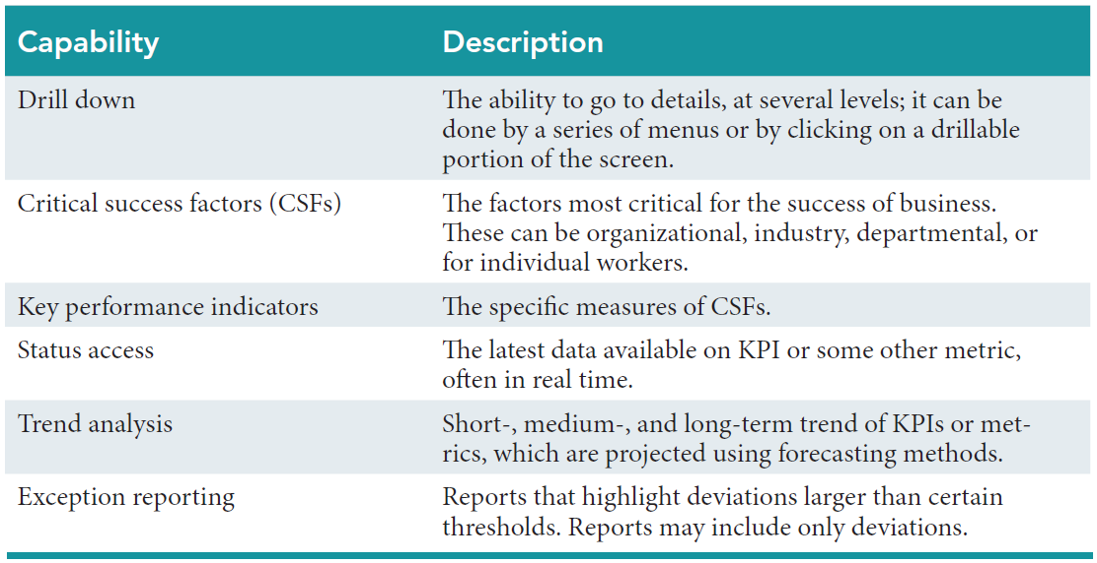
The Capabilities of Dashboards

Slide 23
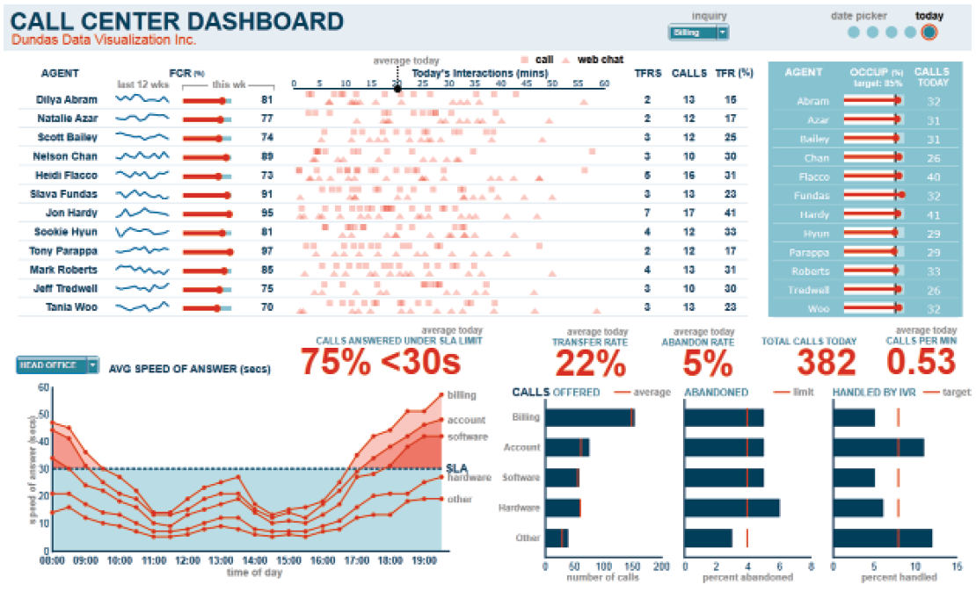
Sample Performance Dashboard

Slide 24
Data Visualization Technologies
Geographic Information System (GIS): a computer-based system for capturing, integrating, manipulating, and displaying data using digitized maps. Its most distinguishing characteristic is that every record or digital object has an identified geographical location.
Reality Mining: Graphical Information Systems (GIS) and Geographic Positioning Systems (GPS) together to produce an interesting new type of technology which allows analysts to extract information from the usage patterns of mobile phones and other wireless devices.
Notes:
Geographic Information System (GIS): a computer-based system for capturing, integrating, manipulating, and displaying data using digitized maps. Its most distinguishing characteristic is that every record or digital object has an identified geographical location.
Reality Mining: Graphical Information Systems (GIS) and Geographic Positioning Systems (GPS) together to produce an interesting new type of technology which allows analysts to extract information from the usage patterns of mobile phones and other wireless devices.

Slide 25
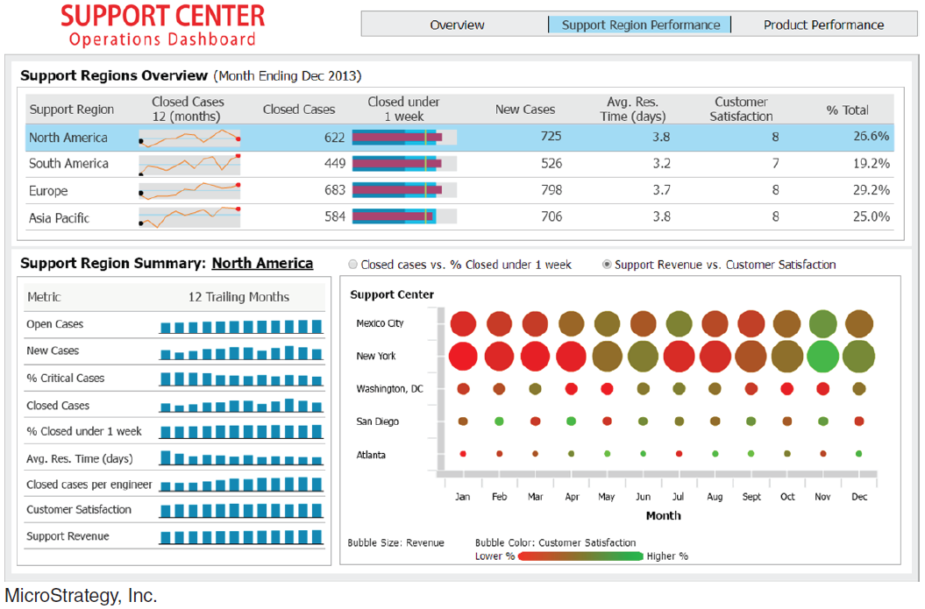
Support Center Operations Dashboard

